Slide 1

Lecture 9 structural variability in leaves

Slide 2
CONTENTS
Structural Variability in leaves of :-
Helianthus (dicot plant)
Aloe (monocot plant)
Calotropis (milkweed, medical plant)

Slide 3
(1) HELIANTHUS
Helianthus is mesophytes.اي ينمو في المناطق المعتدلة
The leaves are large, broad and thin.
The leaf are held horizontally.
Internal structure of Helianthus leaves reveals epidermis, mesophyll and vascular tissue.

Slide 4
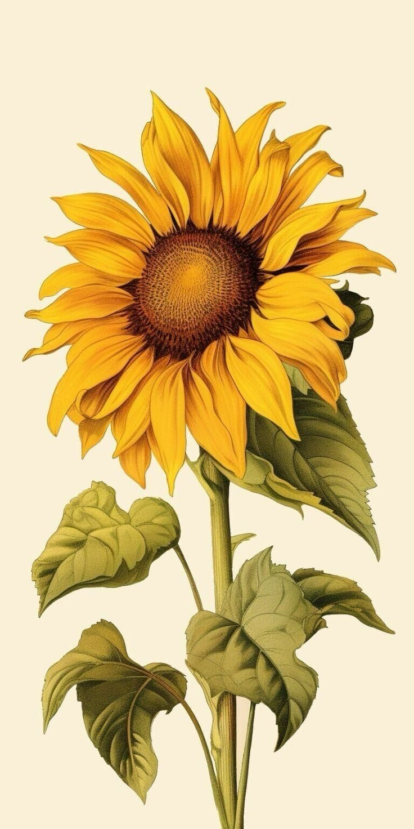

Slide 5
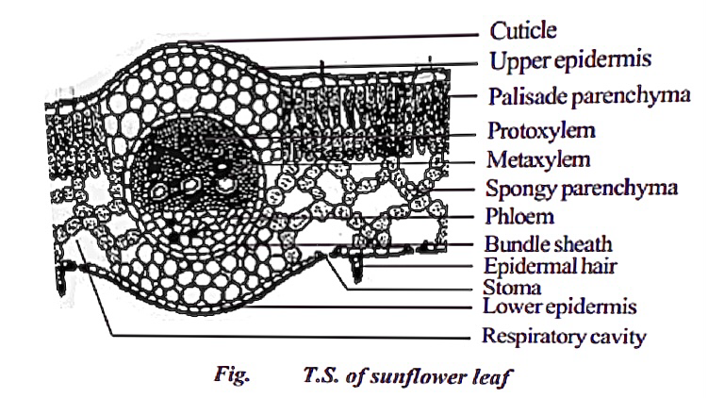




Helianthus leaf

Slide 6
EPIDERMIS
A Helianthus leaves has upper and lower epidermis.
The epidermis is usually made up of a single layer of cells that are closely packed.
The cuticle on the upper epidermis is thicker than that of lower epidermis.
The minute openings found on the epidermis are called stomata.

Slide 7
Stomata are more in number on the lower epidermis than on the upper epidermis.
Each stoma opens into an air chamber.
A stomata is surrounded by a pair of bean shaped cells called guard cells.
The main function of the epidermis is give protection to the inner tissue called mesophyll.

Slide 8
Mesophyll
The entire tissue between the upper and lower epidermis is called the mesophyll.
There are two regions in the mesophyll.
They are Palisade parenchyma and spongy parenchyma.
Palisade parenchyma cells are seen beneath the upper epidermis.

Slide 9
It consists of vertically elongated cylindrical cells in one or more layers.
These cells are compactly arranged without intercellular spaces.
Palisade parenchyma cells contain more chloroplasts than the spongy parenchyma cells.
The function of Palisade parenchyma is photosynthesis.

Slide 10
Spongy parenchyma lies below the Palisade parenchyma.
Spongy cells are irregularly shaped and very loosely arranged with numerous air spaces.

Slide 11
Vascular tissue
Vascular tissue are present in the veins of leaf. Vascular bundles are conjoint, and closed.
Xylem is present towards the upper epidermis, while the phloem towards the lower epidermis.
Vascular bundles are surrounded by a compact layer of parenchymatous cells called bundle sheath or border parenchyma.
Xylem consists of metaxylem vessels and protoxylem vessels.

Slide 12
(2) ALOE
Aloe is xerophytes. (أي ينمو في المناطق الجافة)
In xerophytes certain features are also common.
Leaves are thick and leathery, well developed cuticle and abundant hairs.
Well differentiated mesophyll is also present and there is often more than one layer of palisade tissue.

Slide 13
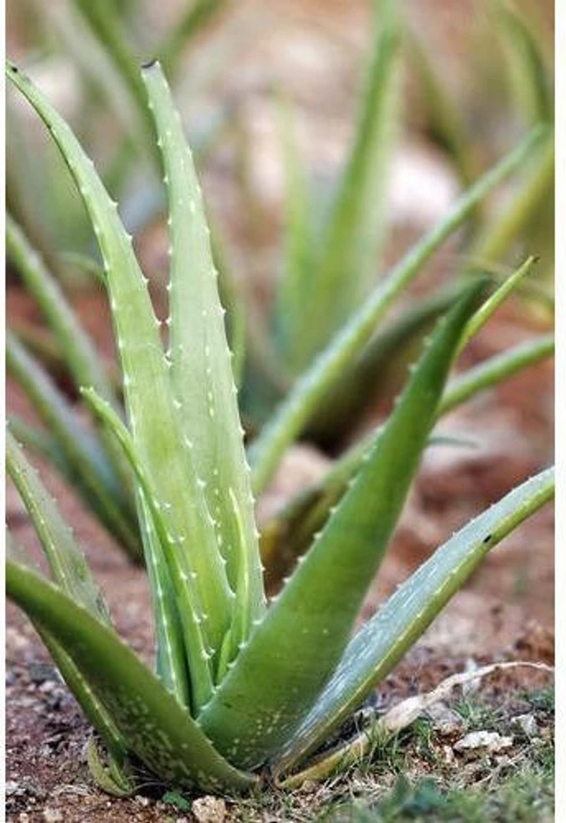
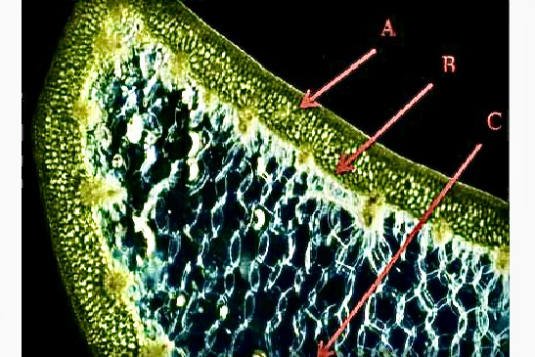


Slide 14
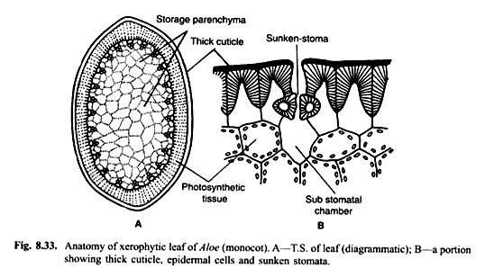
Aloe leaf

Slide 15
In aloe leaves the thick cuticle covering the epidermis had a rough interphase with the outer wall of the epidermal cells.
In the leaves sunken stomata is found.
The stomata is generally protected from the direct contact of outside wind.
The photosynthetic activity is taken up by outer chlrorenchymatous cortex.

Slide 16
In aloe leaves thicker. Thicker leaves have more parenchymatous ground tissue, but the outer chlorenchyma layers containing the green chloroplasts, are common to all.
In the leaves mesophyll is very compact. The intercellular spaces are greatly reduced.

Slide 17
(3) Calotropis
Calotropis is xerophytes.(أي نبات جفافي)
They have much developed cortical region and well developed vascular bundles along with the water storage tissues.
In leaf anatomy, mesophyll tissues are found.
The Vascular bundles in the form of rings.

Slide 18
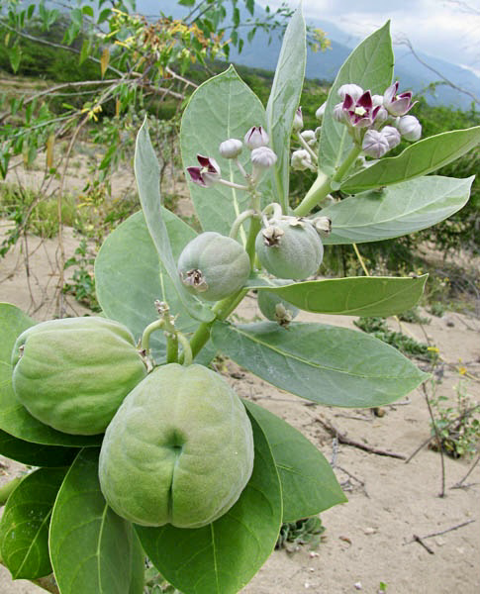

Slide 19
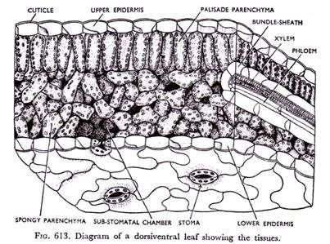
Calotropis leaf

Slide 20
